Slide 1
Introduction
Frese Delta T
Introduction 2017

Slide 2
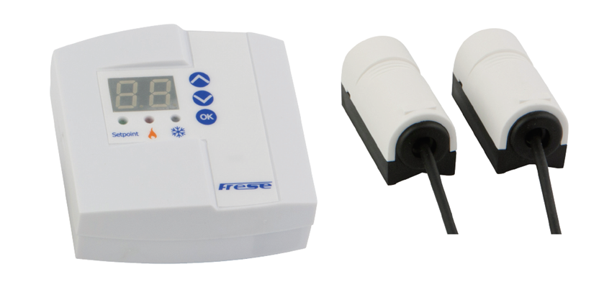
Frese Delta T
Introduction

Slide 3
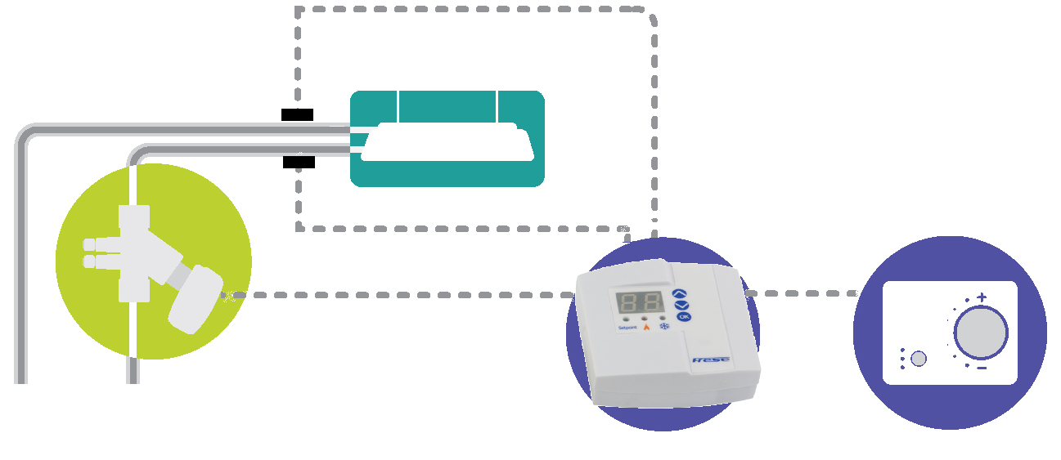
Frese Delta T
Introduction
What is Frese Delta T ?
Frese Delta T is a supply and return temperature controller with two temperature sensors. Frese Delta T limits the flow through the terminal unit by means of a control valve in order to obtain the minimum required (designed) temperature difference in the supply and return lines of the system and thus enhance it’s efficiency and optimize pump energy consumption.

Slide 4
Frese Delta T
ΔT syndrom
At too high flow the efficiency of the system decreases
Design flow pre-set on the valve
If the flow is too high compared to the load, the temperature difference is too low
DT
In a typical cooling system the supply water temperature may be 6ºC and return 12ºC.
That means the desired ΔT is 12-6 = 6ºC.
If the ΔT decreases to 3ºC, the flow increases by a 100%!!!
The same happens in heating systems though the temperatures are of course higher.

Slide 5
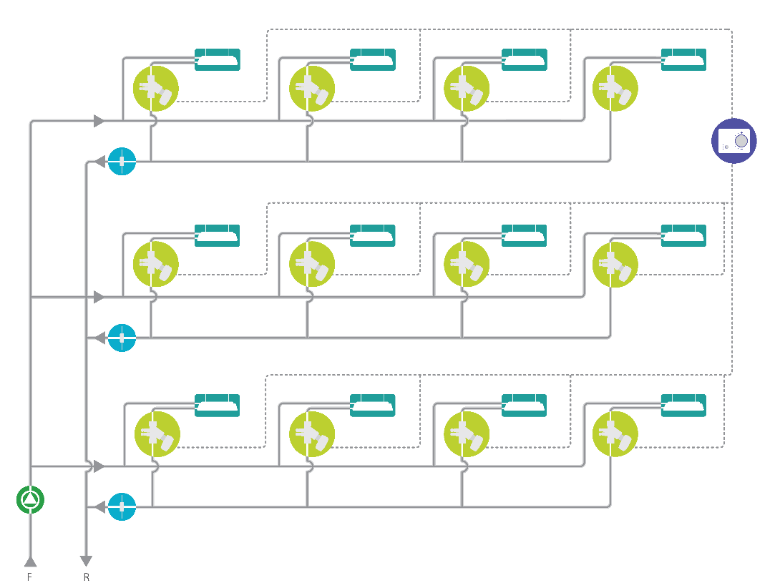

Frese Delta T
ΔT syndrom
System pump with TOO low ΔT:
Too much flow
Too high speed
Too much noise
Too much energy
Too high running cost
Too low system efficiency
System pump with required ΔT:
Pump is not oversized
Low Energy consumption
Low running cost
ΔT is temperature difference between the supply and return line
ΔT
If the ΔT is TOO low compared to what the system has been sized for, the pump operates at TOO high speed and provides TOO much flow using TOO much energy, producing too much noise due to higher pressure loss.

Slide 6
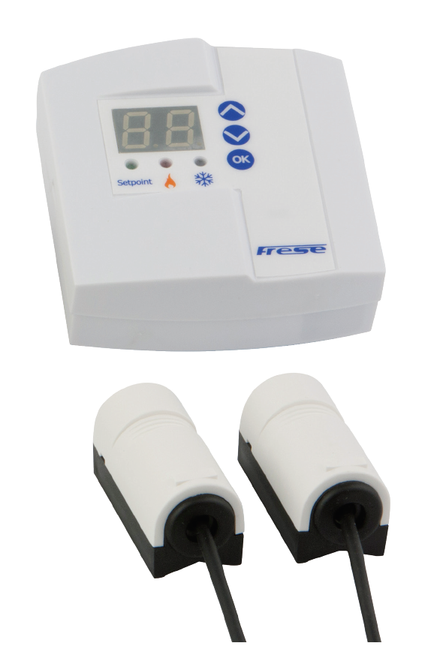
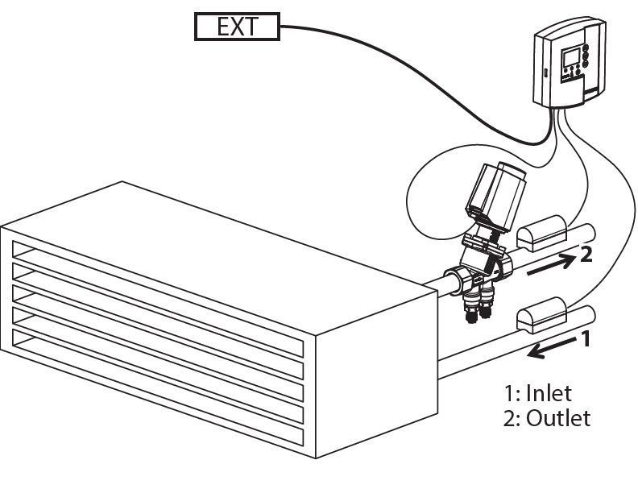
Frese Delta T
The design
Controller
Temperature sensors
Frese DELTA T consists of:
Controller
Two temperature sensors
Straps for fastening the temperature sensors on pipes up to DN300

Slide 7
Frese Delta T
Functionality
It is not important to know which temperature sensors is NO 1 and which NO 2 (they can be swapped). The control box detects this automatically!
Temperature sensor 2
Temperature sensor 1
The temperature sensor 1 is always used as a reference.
Based on the detected temperature by the sensor 1 the controller determines whether the system operates in cooling or heating mode.
The temperature sensor 2 is used to measure the return water temperature and based on this the controller calculates the ΔT.

Slide 8
Frese Delta T
Functionality
Controller
Two way or picv valve
When the measured ΔT is lower compared to the set ΔT the controller sends signal to the picv (or two way valve) to decrease the flow.
If the measured ΔT is equal or higher than the set ΔT the controller takes no action.
The flow is 100% controlled by the external control signal.

Slide 9
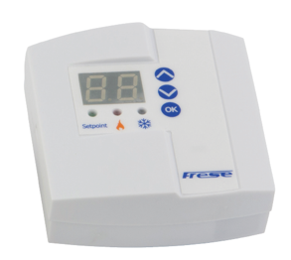
Frese Delta T
Functionality
Min signal 1,5V
To avoid starving the coil of flow the Frese Delta T Control System is programmed so it never sends a signal to the actuator of less than 1.5 V. This means that the DELTA T Control System does not close the valve fully even if the measured ΔT is below the set point. The BMS can always close the valve if the signal sent is less than 1.5V.

Slide 10
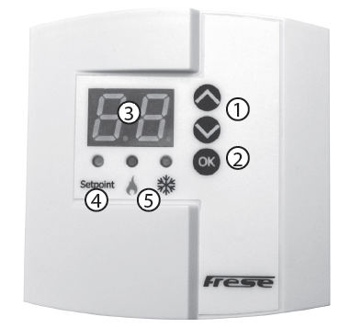
Frese Delta T
Functionality
Setting of ΔT
To set ΔT, button OK (2) should be pressed and held for minimum one second. The set point ΔT value is changed by the buttons (1) and confirmed by the OK button (2)
The display (3) will change between the actual ΔT value and the set point ΔT value. When the set point ΔT is displayed, the green LED (4) will be on. The controller auto-detects and indicates with the red or blue LED (5) whether it operates in heating or cooling systems.

Slide 11
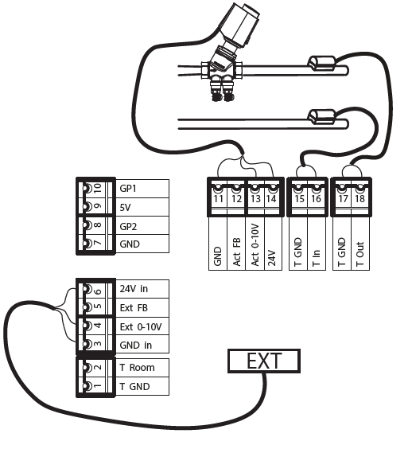
Frese Delta T
Functionality
Wiring
The external control signal of 0-10V (for controlling the actuator) is provided from an external controller to the Frese Delta T control box. The Frese Delta T control box uses 24V power supply and can control a 24V actuator with 0-10V signal. The temperature in the pipe changes the rezistance of the sensors (connected to the Frese Delta T control box) which is converted by the Frese Delta T controll box into temperature reading.

Slide 12
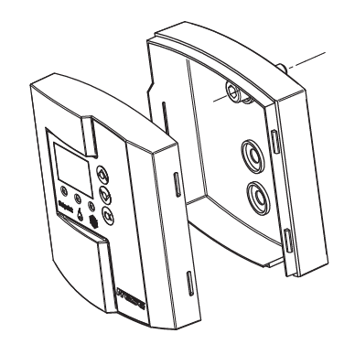
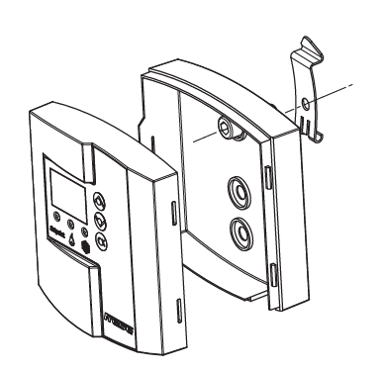
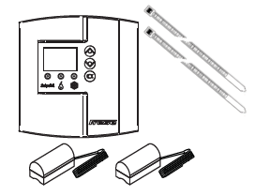
Frese Delta T
Functionality
Mounting on a wall
Mounting with DIN rail clips
Mounting temperature sensors with cable ties
The Frese Delta T control box can be mounted using DIN rail clips or directly on a wall.
The temperature sensors can be mounted on a pipe using cable ties.

Slide 13
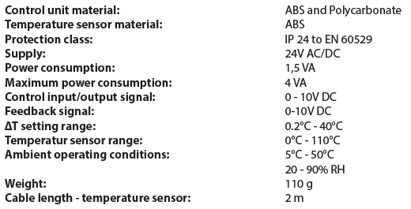
Frese Delta T
Technical data
Controller data
The controller uses 0-10 V signal to communicate with the actuator and 0-10V signal to communicate with the BMS system.

Slide 14
Frese Delta T
Application
Where to install?
The controller must be installed at each terminal unit where flow is controlled by a motorized valve.
One controller can operate one valve.
Frese DELTA T can be used in plant rooms or at air handling units to control single circuits.

Slide 15
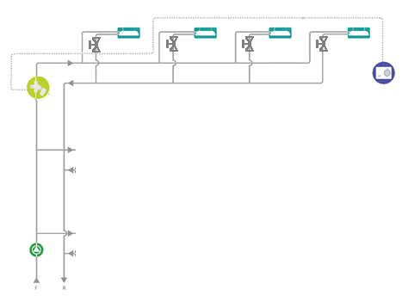
Frese Delta T
Application
One room (area) in the building
Where to install?
Frese DELTA T can be used in branches with several terminal units controlled by one motorized valve.

Slide 16
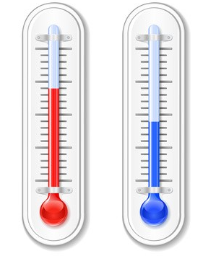






Frese Delta T
Benefits
Solves low ΔT syndrome
Saves pump energy typically more than 50%
Releases additional system capacity
Simple to use in existing
and new system
Plug and „play”
Helps to avoid noise in the system caused by too high flow
Reduces maintenance cost
Increases system efficiency
Increases chiller efficiency

Slide 17

Frese Delta T
Case study
Case study at DTU
The University was founded in 1829 and today is among the top universities in the world and is ranked No. 1 in the Nordic region on the 2011/2012 Leiden Ranking of 500 major universities.
Established in 1960, DTU’s main campus located north of Copenhagen near the town of Lyngby, consists of more than 100 buildings and covers an area of 106 hectares. With approximately 9,000 students and 5,500 staff, DTU is currently (2017) investing more than DKK 4 billion in its campus development to create optimum conditions for research and education with state-of-the-art facilities.

Slide 18
Frese Delta T
Case study
The DTU Lyngby campus, which consists of more than 100 buildings and covers an area of 106 hectares, is served by a district cooling network providing cooling for laboratories, data centers and classrooms.
As more buildings have been added to the campus over the years, the capacity of the cooling network has not been developed to meet the extra demand. Consequently, the cooling capacity of the current system has now reached its limit. DTU have been considering a number of options to try and increase the capacity of the cooling system, including upgrading and upsizing the distribution pipework.

Slide 19
Frese Delta T
Case study
During investigation, poor ΔT’s within the system were identified as part of the capacity problem. The district cooling system has a design ΔT of 6°C, but many buildings were found to be running with an actual ΔT of between 1°C and 3°C.

Slide 20
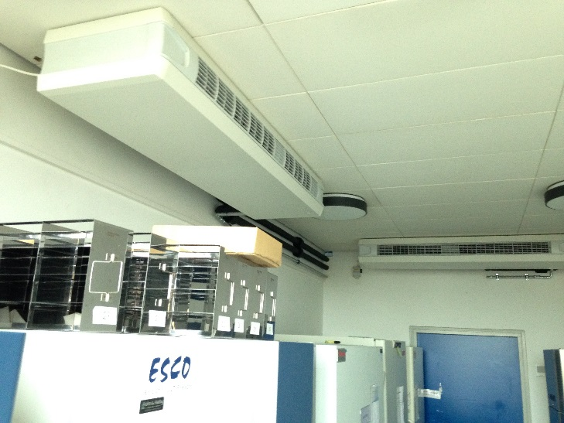
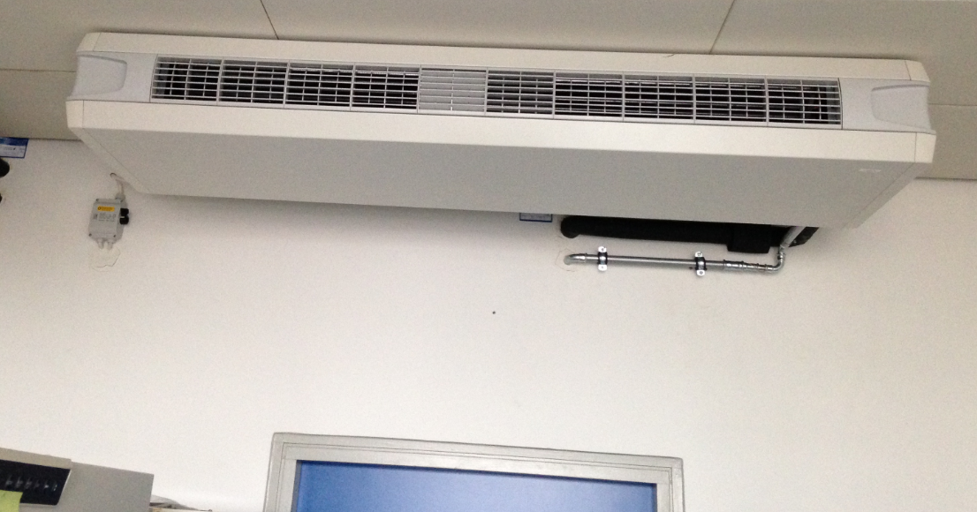
Frese Delta T
Case study
A laboratory building was selected as the test site for the Frese DELTA T Control System and within this building, the freezer room which houses multiple -80°C freezers.
The freezers expel large amounts of heat in to the room and the room temperature is controlled by two fan coil units.
Initially, the water flow to the fan coil units was controlled by a DN15 static 2-way control valve and 0-10V modulating actuator.
The room temperature is stable at 21°C

Slide 21
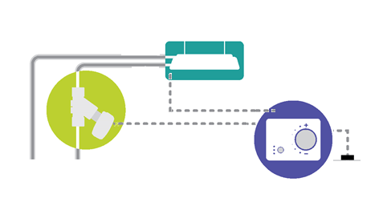
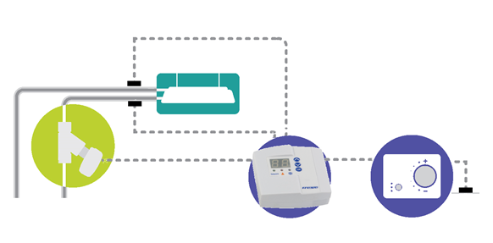
Frese Delta T
Case study
Part 1:
Static 2-way control valve and 0-10V modulating actu-ator, without Frese Delta T Control
Part 2: Static 2-way control valve and
0-10V modulating actuator, with Frese Delta T Control

Slide 22
Frese Delta T
Case study
Part 1:
Static 2-way control valve and 0-10V modulating actuator, without Delta T Control
Part 2: Static 2-way control valve and 0-10V modulating actuator, with Delta T Control
Initially, the water flow to the fan coil units was controlled by a DN15 static
2-way control valve and 0-10V modulating actuator.
The room temperature is stable at 21°C

Slide 23
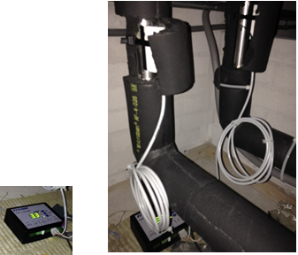
Frese Delta T
Case study
Part 1:
Static 2-way control valve and 0-10V modulating actuator, without Delta T Control
Part 2: Static 2-way control valve and 0-10V modulating actuator, with Delta T Control
The Delta T Control System was used to measure and monitor, for a period of one week, the current Delta T being achieved with the original installation setup.
The Frese Delta T Control System can be used as a diagnostic tool, as well as a control system, to collect and analyze data from existing systems.

Slide 24
Frese Delta T
Case study
Part 1:
Static 2-way control valve and 0-10V modulating actuator, without Delta T Control
Part 2: Static 2-way control valve and 0-10V modulating actuator, with Delta T Control
In this part of the study there is no control of the ΔT. The control box monitors both the BMS control signal and the flow and return water temperatures to and from the fan coil.

Slide 25
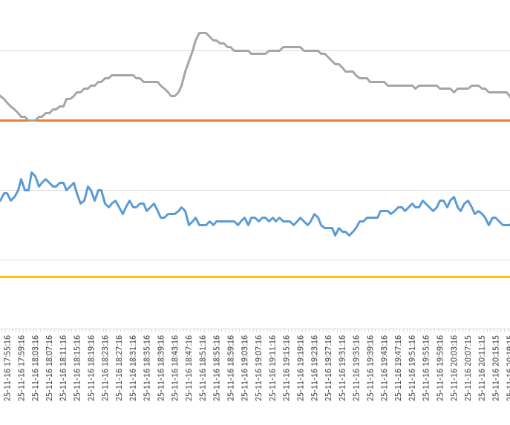
Frese Delta T
Case study
Part 1:
Static 2-way control valve and 0-10V modulating actuator, without Delta T Control.
Grey: BMS signal to control box (0-10VDC)
Orange: ΔT setpoint 5.0°C
Blue: Actual measured ΔT
Yellow: Frese Delta T signal to valve actuator (zero signal as monitoring only)
Part 2: Static 2-way control valve and 0-10V modulating actuator, with Delta T Control
Cooling Demand ~ 5.7 kW
Room temperature was stable at 21°C.
Average measured ΔT, over the 1 week period, was 3.1°C versus a setpoint of 5.0°C.
Actual measured flow from the coil was 1.60 m³/h (0.44 l/s).

Slide 26
Frese Delta T
Case study
Part 2: Static 2-way control valve and 0-10V modulating actuator, with ΔT Control
Static 2-way control valve and 0-10V modulating actuator, with ΔT Control

Slide 27
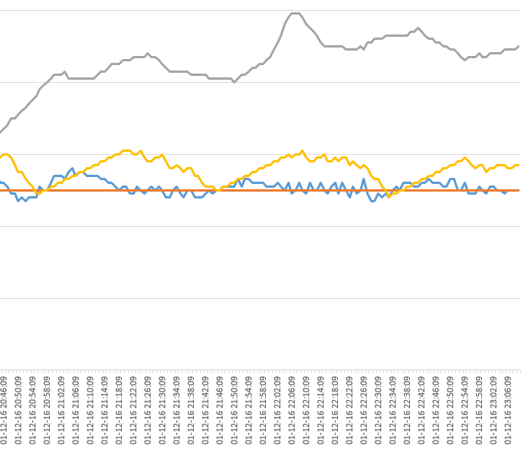
Frese Delta T
Case study
Part 2: Static 2-way control valve and 0-10V modulating actuator, with ΔT Control
Grey: BMS signal to control box (0-10VDC)
Orange: ΔT setpoint 5.0°C
Blue: Actual measured ΔT
Yellow: Frese Delta T control box signal to valve actuator (0-10V)
Part 2: Static 2-way control valve and 0-10V modulating actuator, with Delta T Control
Cooling Demand ~ 5.7 kW
Room temperature was stable at 21°C.
Average measured ΔT, over the 1 week period, was 5.1°C versus a setpoint of 5.0°C.
Actual measured flow from the coil was 0.986 m3/h (0.27 l/s)

Slide 28
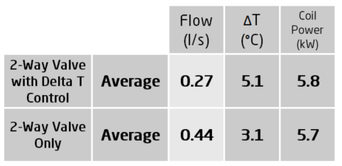
Frese Delta T
Case study
The average flow is lower
The Coil ΔT is higher

Slide 29
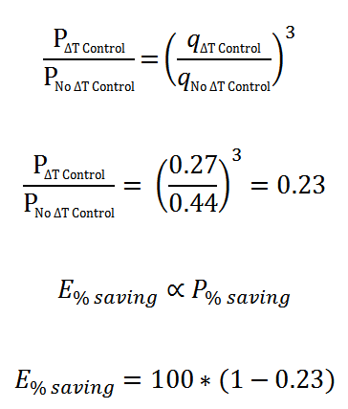
Frese Delta T
Case study
When fitted with a Static 2-Way Control Valve and Frese ΔT Control, the same FCU can satisfy the same cooling load with 77% less pump energy consumption compared with when controlled by a Static 2-Way Control Valve only.
E% saving = 77%

Slide 30

Frese Delta T
Case study
No Frese Delta T
With Frese Delta T
Comparison of:
2 way control valve
Vs
2 way control valve with Frese Delta T
E% saving = 77%
2 way control valve Vs 2-way control valve with Frese Delta T:
2-way control valve, cooling capacity 5.6kW, flow 1600l/h, ΔT=3ºC, pump energy 100%
2-way control valve with Frese Delta T, cooling capacity 5.6kW, flow 980l/h, ΔT=5ºC, pump energy 23%.

Slide 31
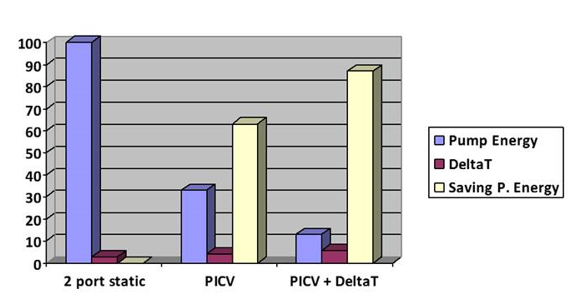
Frese Delta T
Case study
Comparison of:
2 way control valve
Vs
PICV
E% saving = 67%
2 way control valve Vs PICV (no Frese Delta T):
2-way control valve, flow 1600l/h, DT=2.8ºC,
PICV, flow 1100l/h, ΔT=4.1ºC,
Pump energy saving 67%

Slide 32
Frese Delta T
Case study
PICV with Frese Delta T
All the tests have been carried out at DTU – Technical University and the test results indicate that the greatest saving in energy has been recorded when
Frese Delta T had controlled a picv valve – Frese Optima Compact.

Slide 33
Frese Delta T
Way to the market
New buildings?
Retrofit?
Contractor?
Building owner?
Facility manager
Installer?
DELTA T Vs BMS?
DELTA T Vs PICV?
DELTA T Vs nothing?
...
...
Diagnostic box?
Where and how to use Frese Delta T?
There may be different ways to the market depending
on the situation in the market in question.
There is at the moment no device in the market capable
of providing the same functionality on any motorized valve.
Frese can also offer the diagnostic box to collect and process data for the customer.

Slide 34
Frese Delta T
Way to the market
Next best alternative | Audience/Route to Market | Situation(s)
BMS | Consultant | New build
PICV | Contractor | Retrofit
Belimo Energy Valve | Owner | Problematic building
Do nothing | Facilities Management
One of suggested ways to the market:
If the customer experiences ΔT issues, it should be possible to take direct contact to the building owner or the facility management.
The existing and causing problems buildings should be in the focus of attention.
The diagnostic box can be used to prove that the ΔT problem persists and Frese Delta T, perhaps along with some picv valves, can help.

Slide 35
Frese Delta T
Way to the market
Next best alternative | Audience/Route to Market | Situation(s)
BMS | Consultant | New build
PICV | Contractor | Retrofit
Belimo Energy Valve | Owner | Problematic building
Do nothing | Facilities Management
Another suggested way to the market:
If the customer experiences ΔT issues, it should be possible to take contact to a consultant who can advise the customer on the course of action.
The existing and causing problems buildings should be in the focus of attention.
The diagnostic box can be used to prove that the ΔT problem persists and Frese Delta T, perhaps along with some picv, valves can help .

Slide 36

Frese Delta T
Discussion
Any questions?

Slide 37
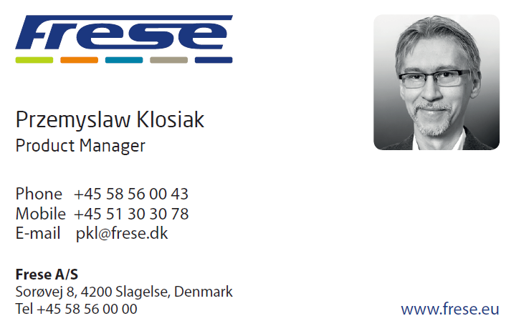
Frese Delta T
Contact
In case of questions please contact product manager:
Thank you ☺

